Slide 1
MISSION UPDATES
August 2026

Slide 2
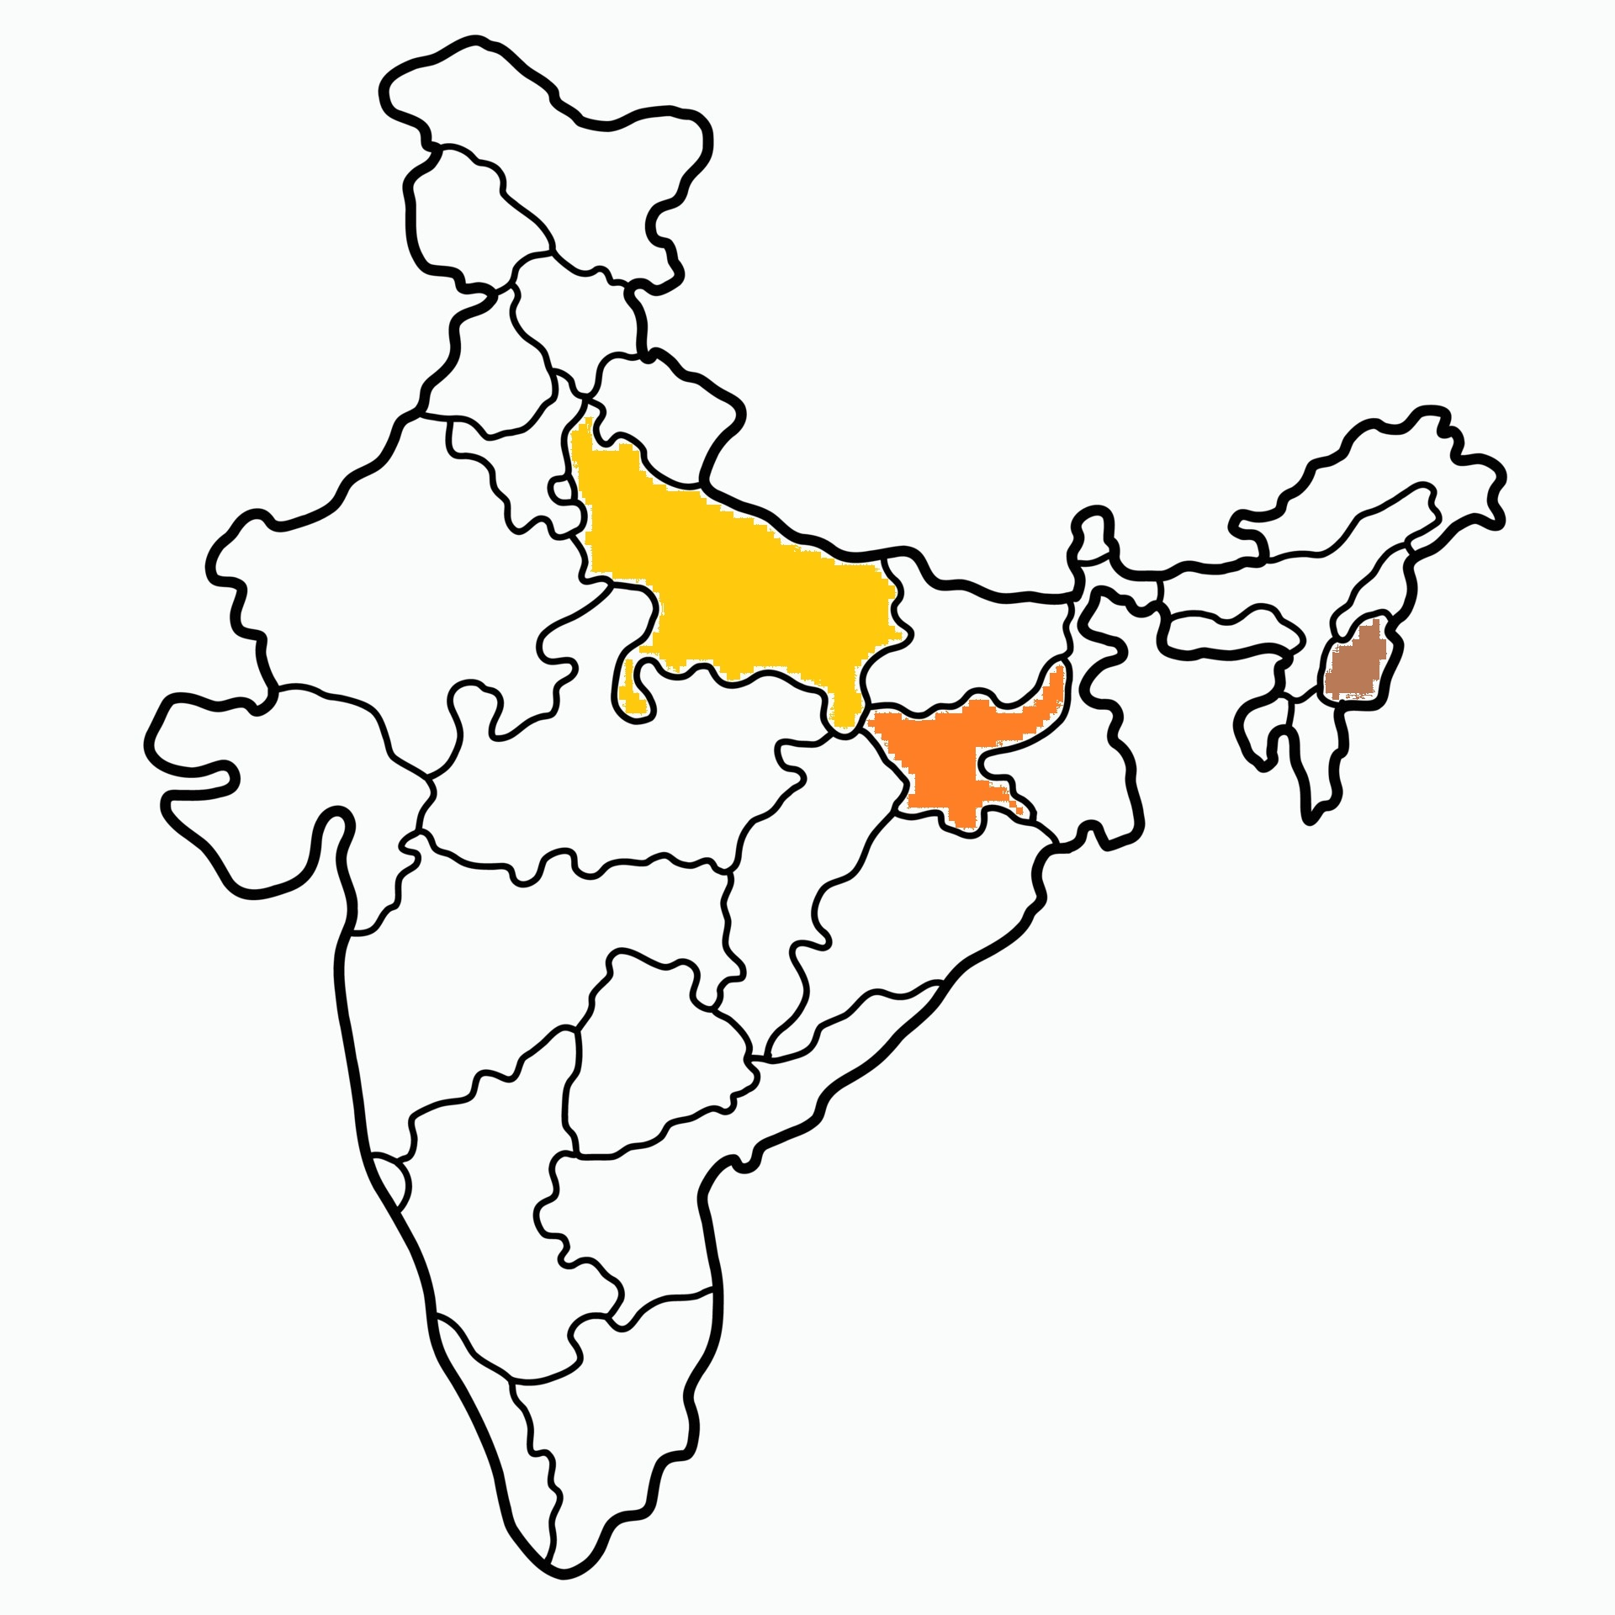

Slide 3
Mission Stations
10 mission stations supported in Jharkhand – Khunti Dist.
5 mission stations supported in U.P. – Balia(2) and Varanasi Dist. (3)
1 ICPF workstation supported in North-east India (Dimapur).

Slide 4
NORTH INDIA MISSION
UP
5 Stations - ₹3000 each
Balia and Varanasi
Jharkhand
10 Stations - ₹3000 each
Khunti District
ICPF
1 Station - ₹5000
Dimapur

Slide 5
JHARKHAND

Slide 6
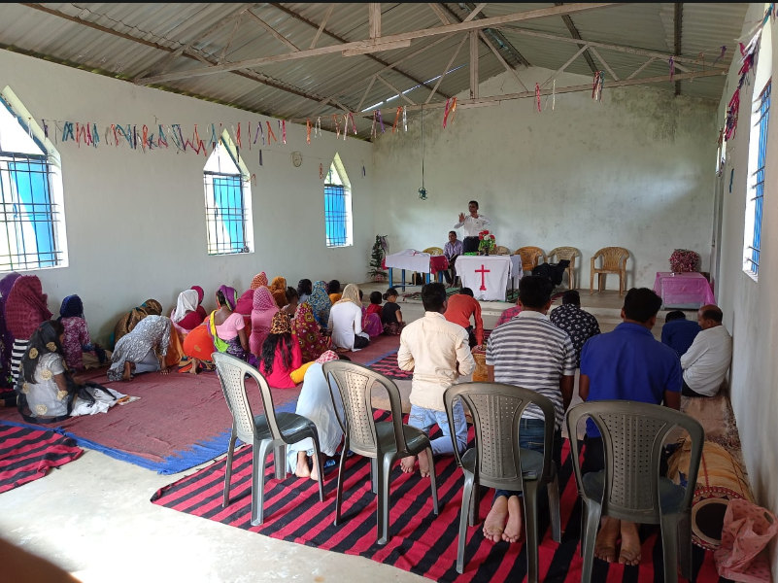
Fasting Prayer

Slide 7
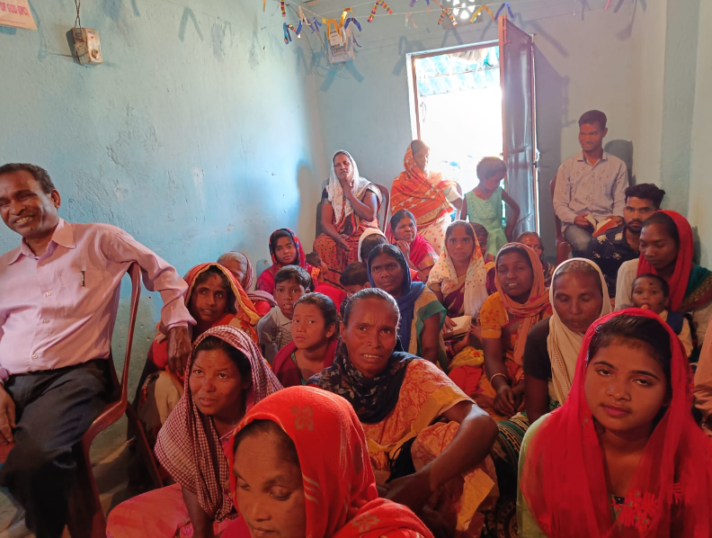
Village Ministry

Slide 8
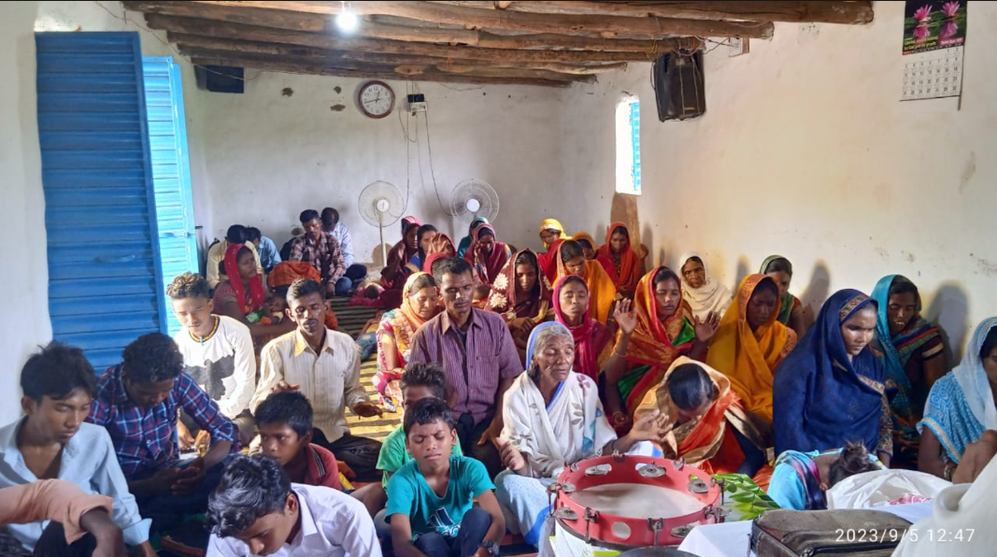
Sunday Service

Slide 9
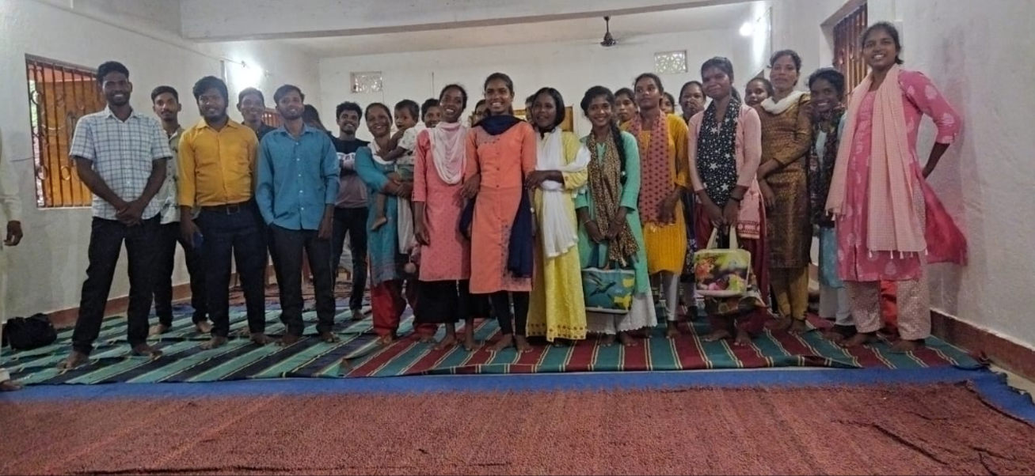
Youth Meeting

Slide 10
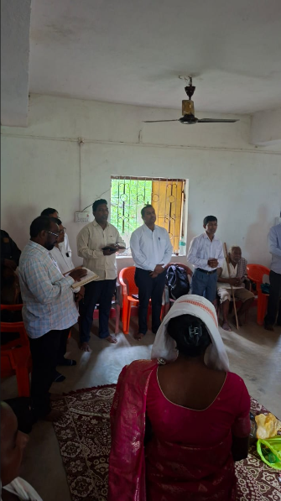
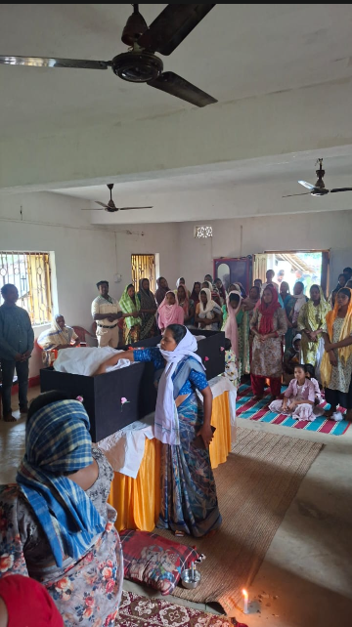
Funeral Service
Please pray for the bereaved families.

Slide 11
Thank You

